Slide 1
Synchronizing Tests
Building robust and reliable tests is one of the critical success factors of automated UI testing. When your script searches for elements or a certain state of application and it cannot find these elements anymore because the application starts responding slowly due to sudden resource constraints or network latency, the tests report false negative results.
We need to match the speed of the test script with the application's speed by introducing delays in the test script. In other words, we need to sync the script with the application's response.
WebDriver offers implicit and explicit waits to synchronize tests.

Slide 2
Using implicit wait
Implicit wait is useful in dealing with situations where the application's response time is inconsistent due to network speed or applications that use dynamically rendered elements with Ajax calls.
When we set an implicit wait on WebDriver, it polls or searches the DOM for a certain amount of time to find an element or elements if they are not immediately available. By default, the implicit wait timeout is set to 0.

Slide 3
Synchronizing Tests
Once set, the implicit wait is set for the life of the WebDriver instance or for the entire duration of the test, and the WebDriver applies this implicit wait for all the steps that find the elements on the page unless we set it back to 0.
The webdriver class provides the implicitly_wait() method to configure timeout.

Slide 4
Using explicit wait
The explicit wait is another wait mechanism available in WebDriver to synchronize tests. Explicit wait provides a better control when compared to implicit wait. Unlike an implicit wait, we can use a set of predefined or custom conditions for the script to wait for before proceeding with further steps.
An explicit wait can only be implemented in specific cases where script synchronization is needed. WebDriver provides the WebDriverWait and expected_conditions classes to implement an explicit wait.
The expected_conditions class provides a set of predefined conditions to wait for before proceeding further in the code.

Slide 5
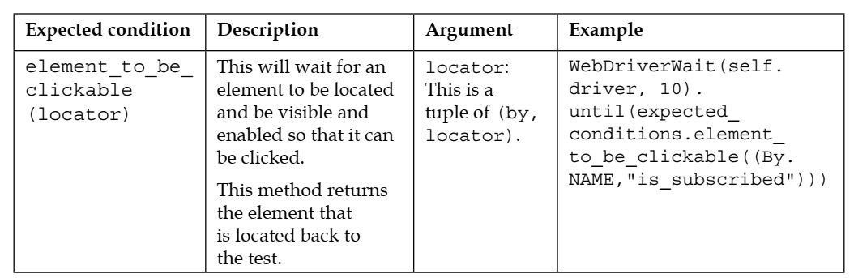

Slide 6
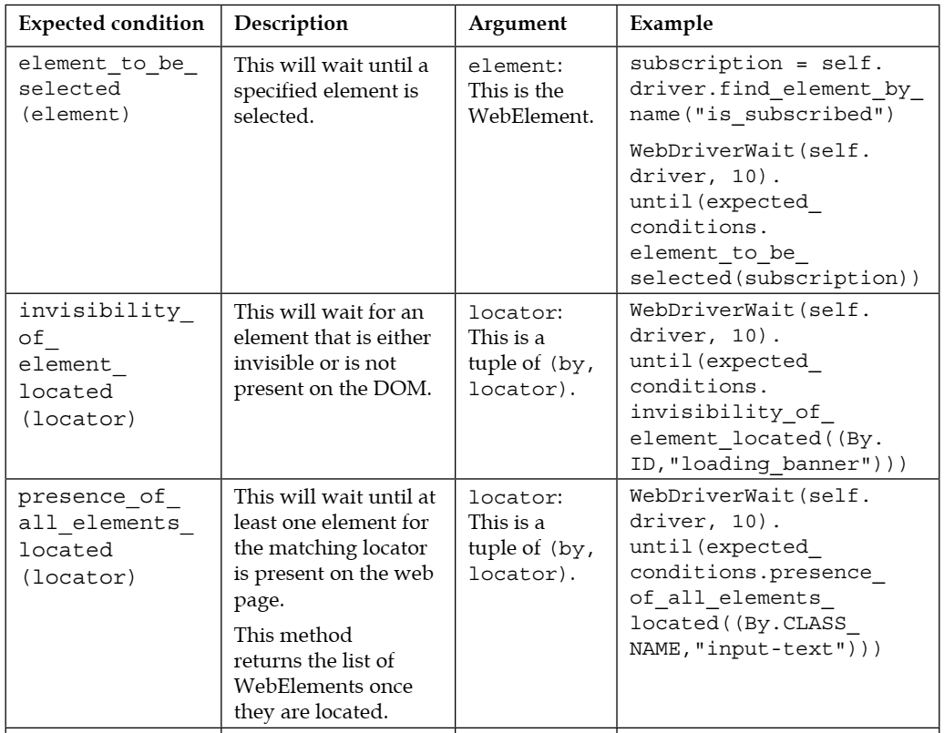
Synchronizing Tests

Slide 7
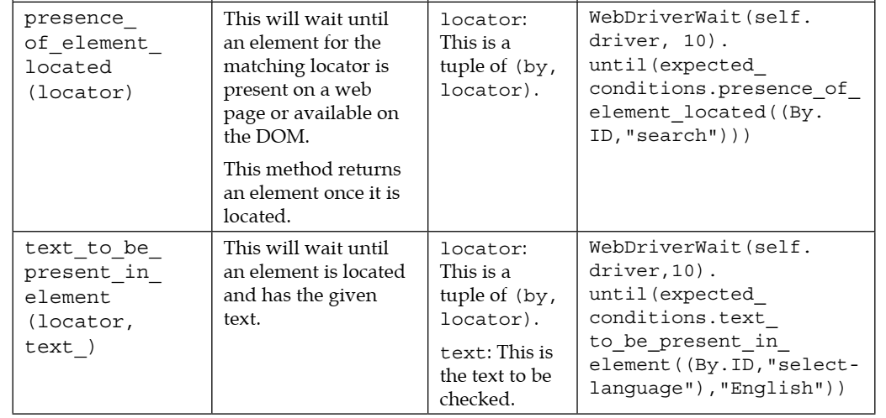
Synchronizing Tests

Slide 8
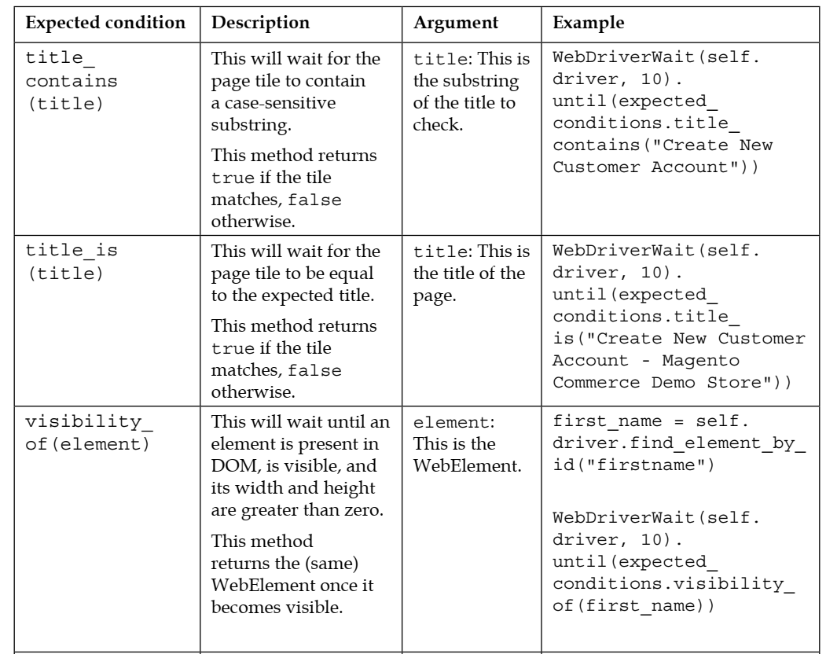
Synchronizing Tests

Slide 9
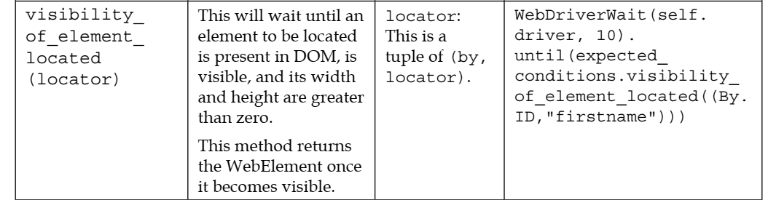
Synchronizing Tests

Slide 10
import time import unittest # from selenium import webdriver from selenium.webdriver.chrome.service import Service from selenium.webdriver.common.by import By from selenium.webdriver.support import expected_conditions from selenium.webdriver.support.wait import WebDriverWait obj=Service("C:/Users/belayneshbiadgilign/Desktop/chromedriver") driver=webdriver.Chrome(service=obj) driver.implicitly_wait(10) driver.get("http://hepsiburada.com/") driver.maximize_window() element=driver.find_element(By.XPATH,"//input[@class='desktopOldAutosuggestTheme-UyU36RyhCTcuRs_sXL9b']") # element.send_keys("HiRKA") #element2=driver.find_element(By.XPATH,"//span[contains(text(),'Günlük Hırka')]") element2=WebDriverWait(driver, 10).until(expected_conditions.visibility_of_element_located((By.XPATH,"//span[contains(text(),'Günlük Hırka')]"))) element2.click() time.sleep(10)

